Slide 1

RESEARCH CENTRE IMARAT
DIRECTORATE OF EMBEDDED AND ARTIFICIAL INTELLIGENCE SYSTEMS
Project presentation
on
UAV Swarm Formation & Path Planning
RCI Guide: Archana Ma’am & Sai Charan Sir Anup Kumar Tiwari →College Guide: Dr. Soumya S.
Akshaan Gupta →College Guide: Dr. MM Kuber Asuwin.J →College Guide: Dr. MM Kuber

Slide 2
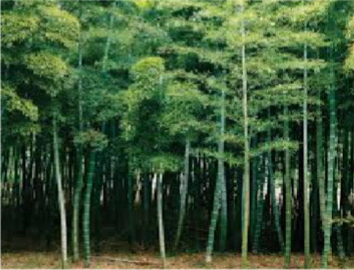
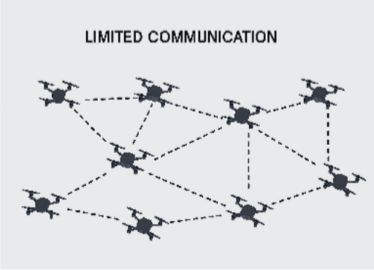
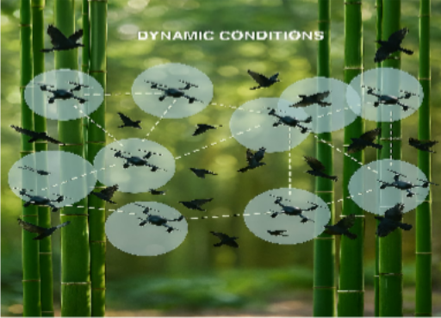
Problem Statement
UAV swarm in complex Environment :
Dense Obstacles
Limited communication range
Dynamic Conditions
Need for robustness, scalable and autonomous coordination.

Slide 3
Objectives
Simulation in Unreal Engine using Colosseum.
Decentralized Control:
Formation Control
Path planning
Obstacle Avoidance
Task allocation
Effective navigation

Slide 4
Literature Survey
Name
Authors
Year of Publication
Comments
1.
Formation Control for Multiple Unmanned Aerial Vehicles in Constrained Space using Modified Artificial Potential Field.
Hang Yin, Lea L. Cam, Utpal Roy
2017
Proposed artificial potential field for formation control.
2.
A Proximal Policy Optimization Method in UAV swarm formation Control
Ning Yu, Feng Juan,
Hongwei Zhao
2024
Used Reinforcement Learning for adaptive swarm behaviour.
3.
Swarm of Micro Flying Robots in the Wild
Xin Zhou, Xiangyong Wen, Zhepei Wang
2022
Demonstrated real-world UAV swarm navigation in forests using decentralized control in a complex environment.

Slide 5
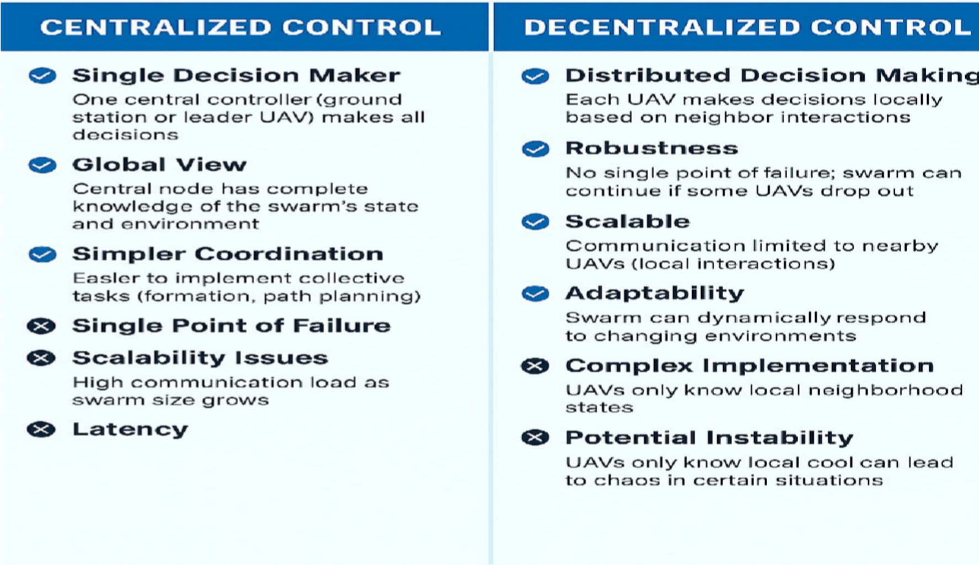
UAV Swarm Control

Slide 6
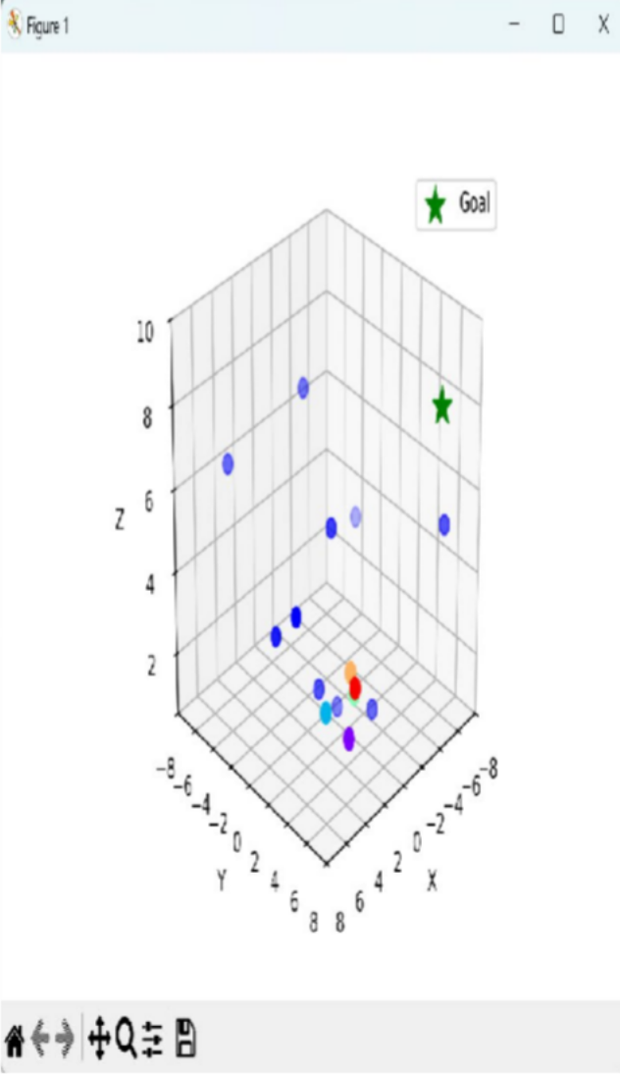
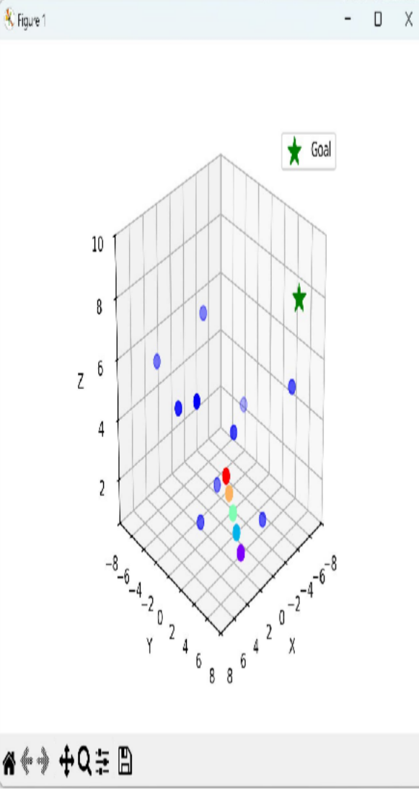
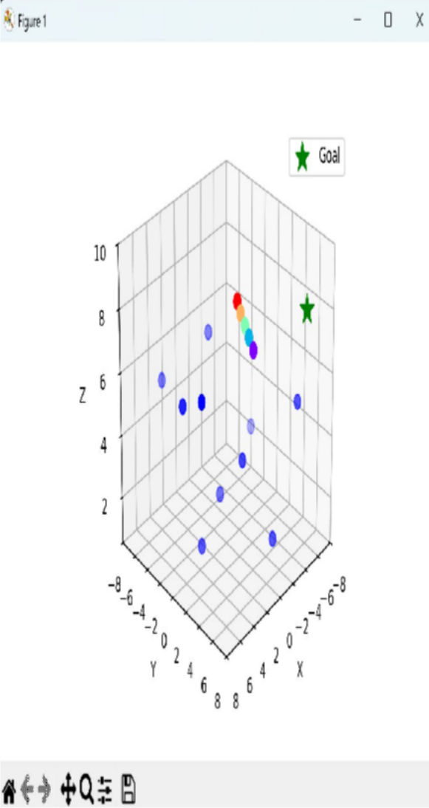
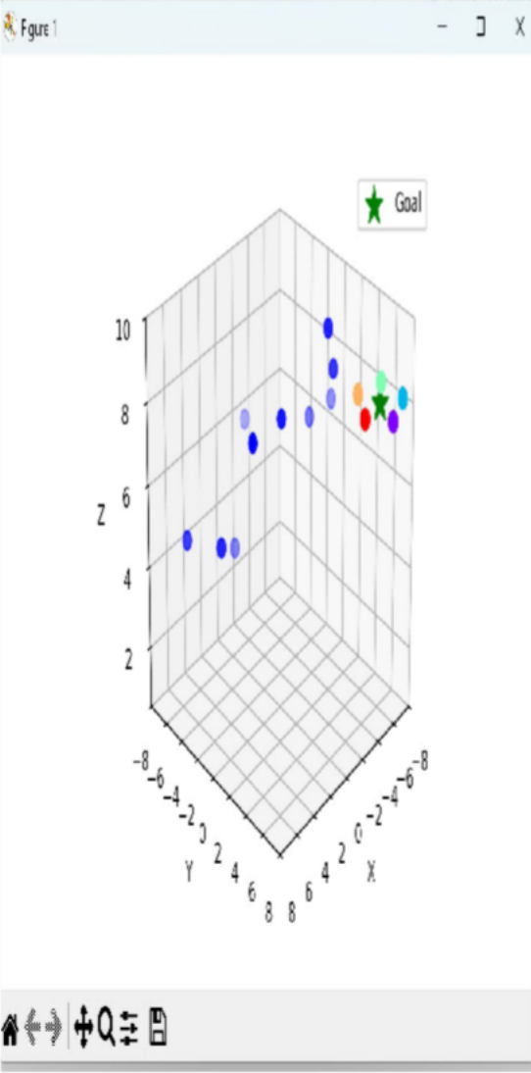
Work Done so Far - Centralized Control

Slide 7
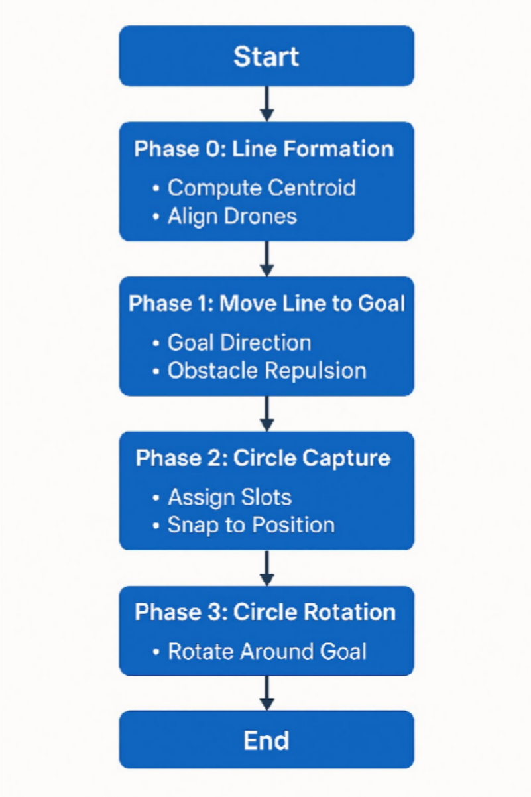
FLOWCHART

Slide 8
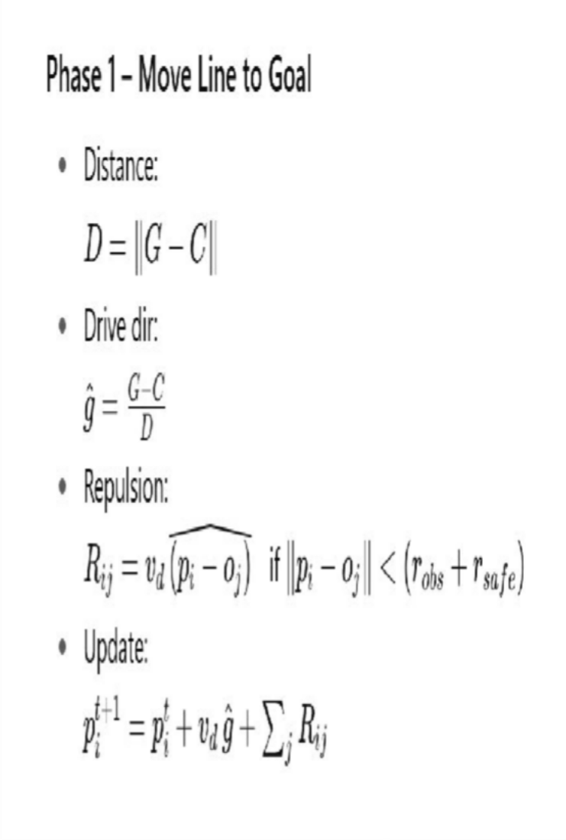
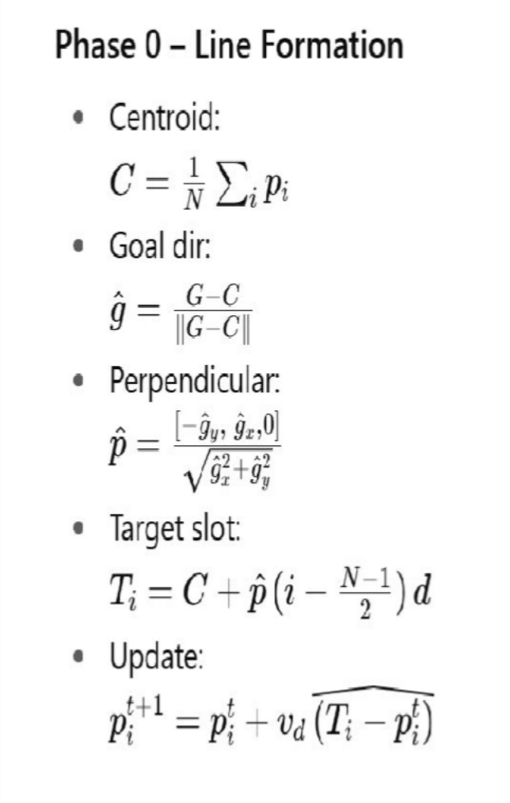
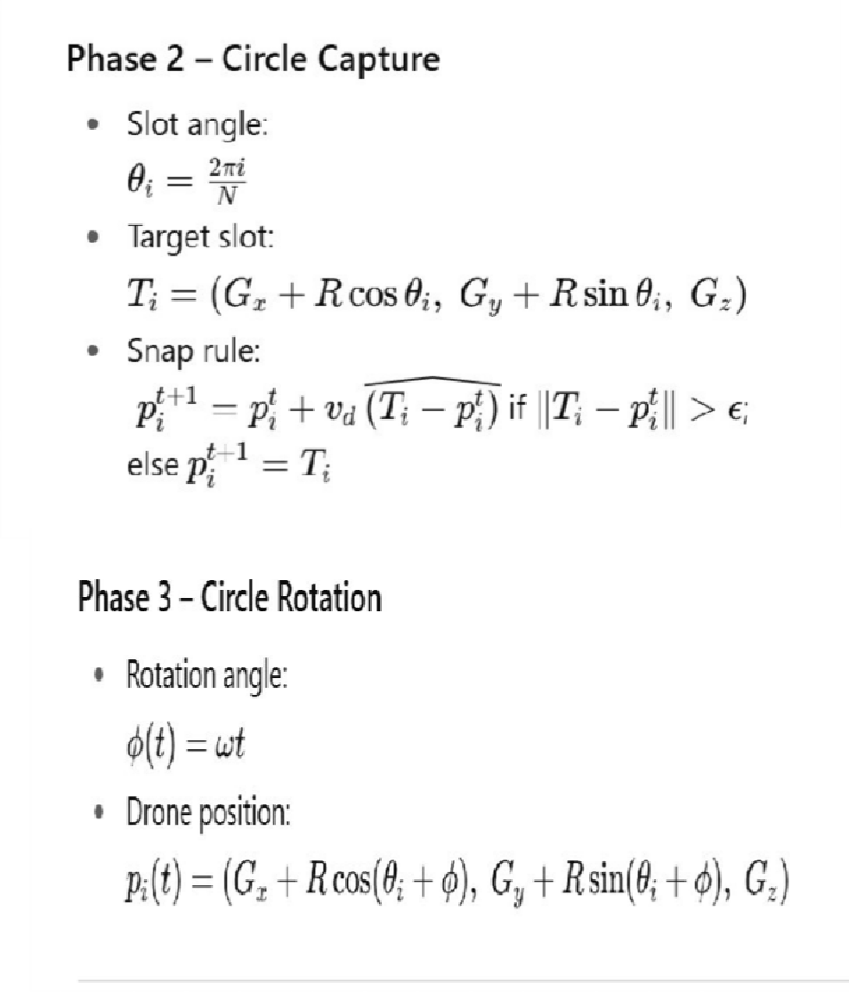
Phase-wise Equations - Centralized Control

Slide 9
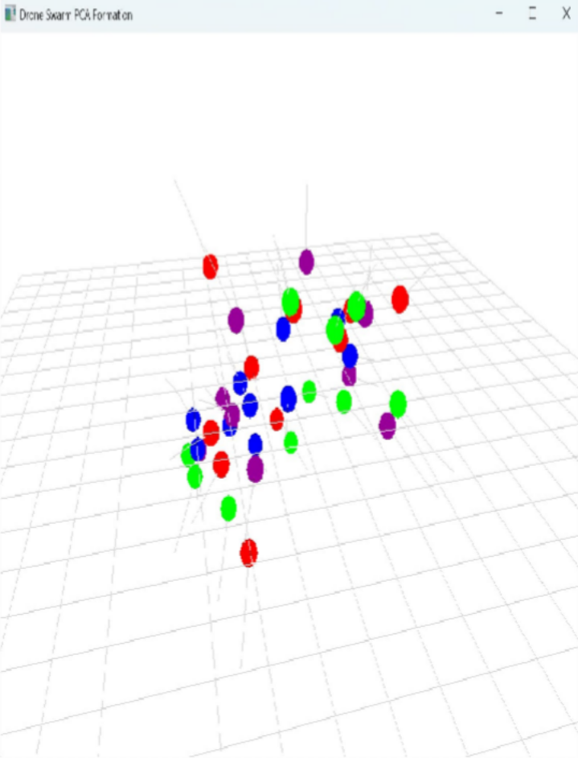
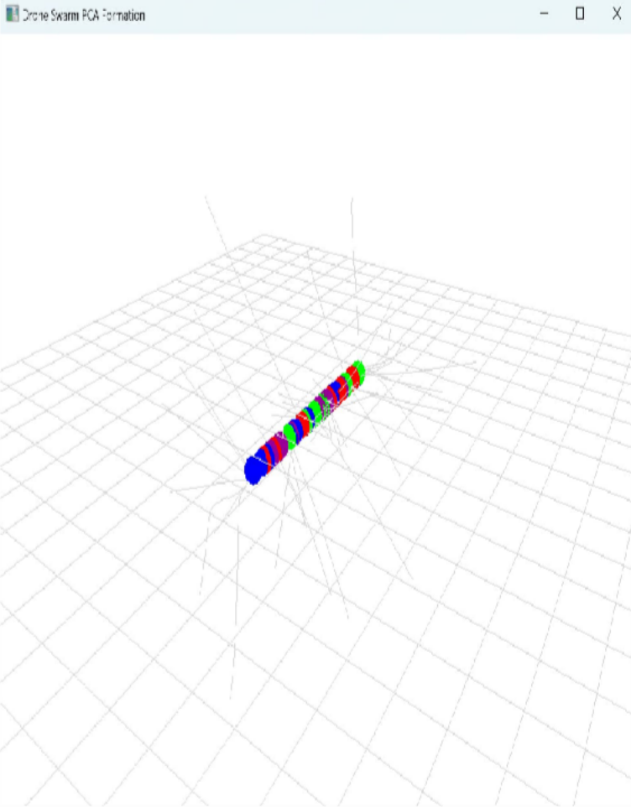
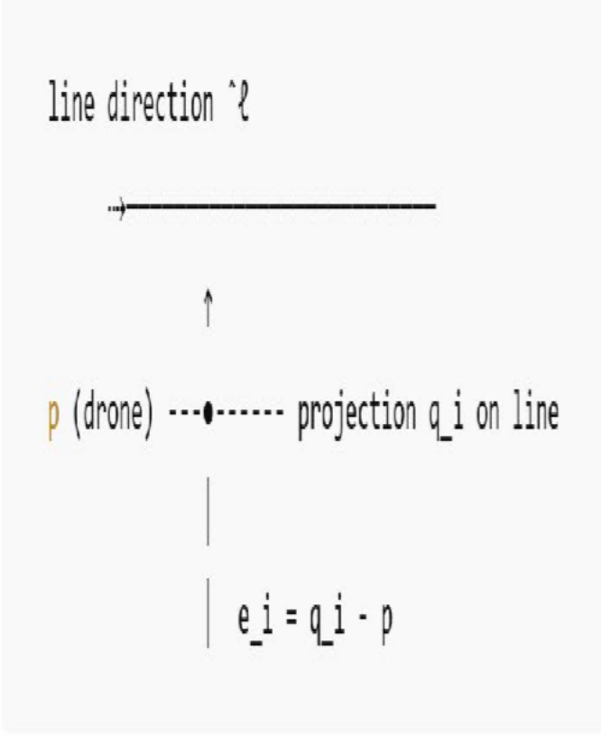
Work Done so Far - Straight line formation using Decentralized Control
Flow Chart

Slide 10
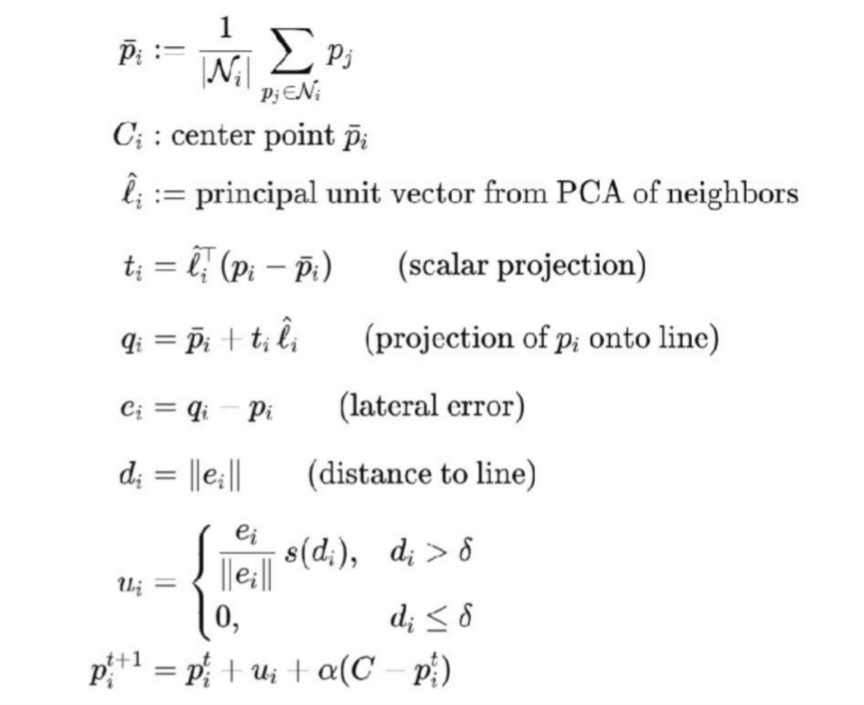
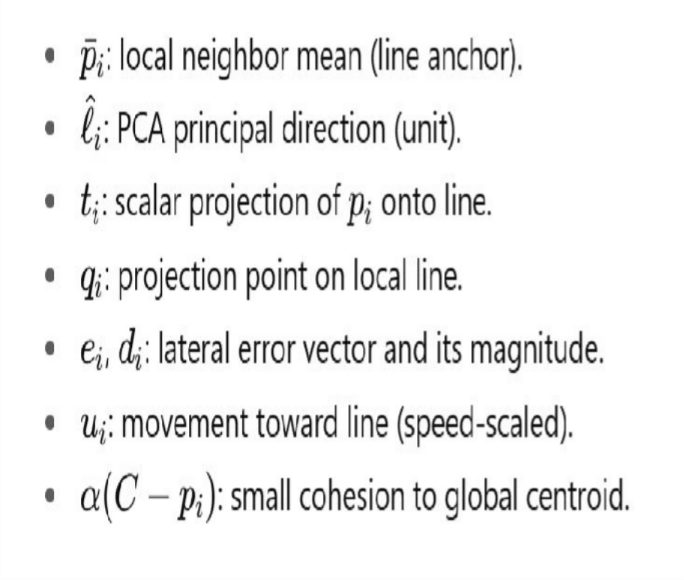
Equations used : Decentralized Control

Slide 11
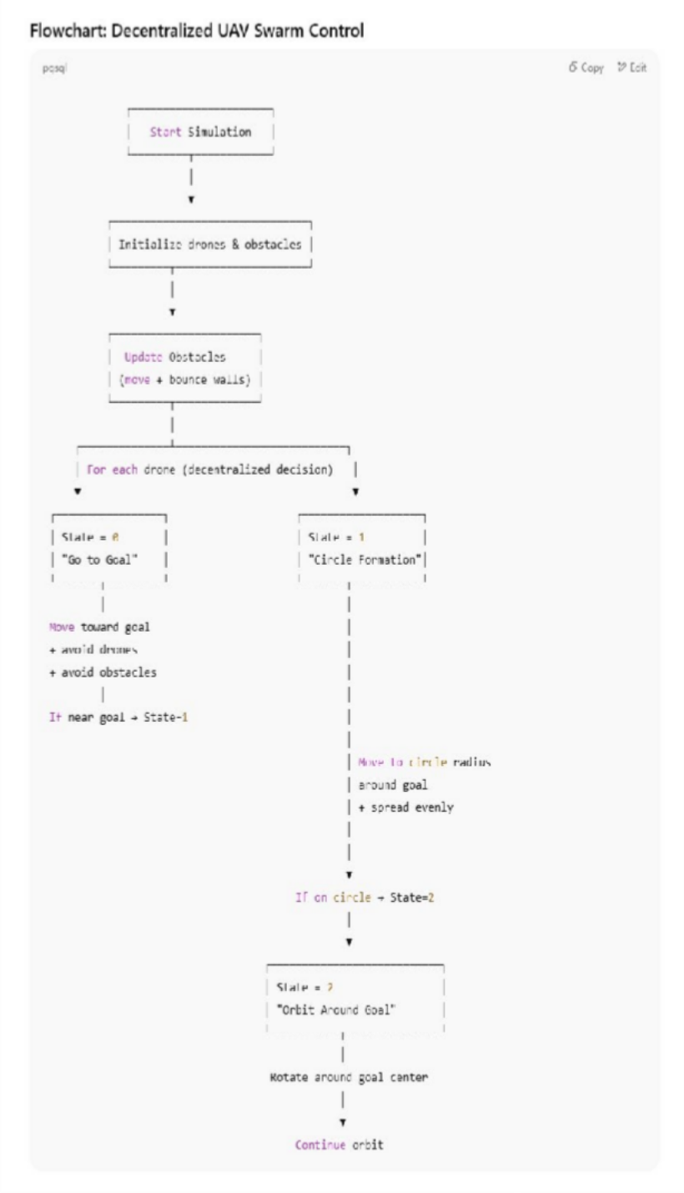
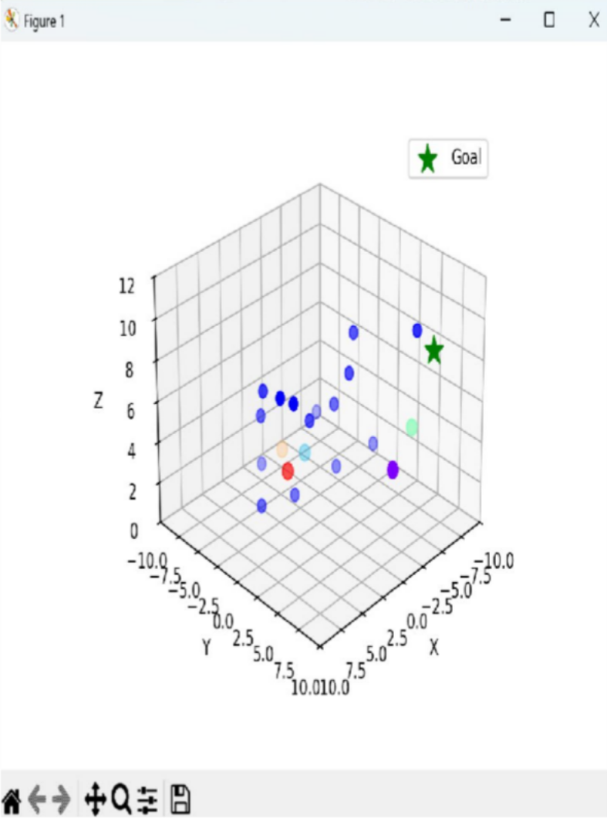
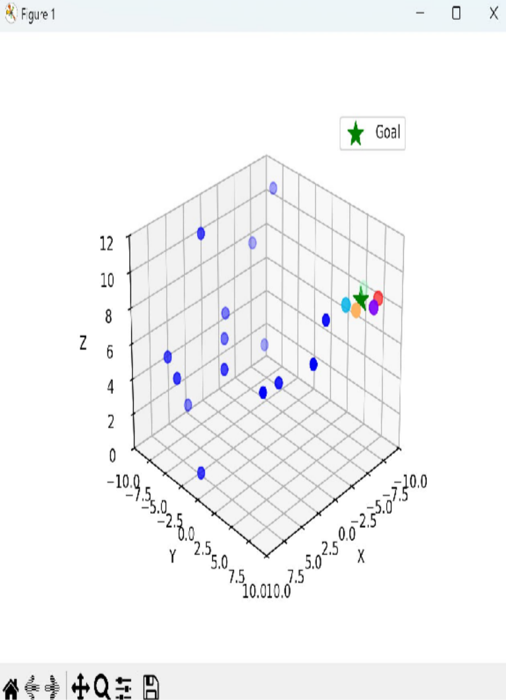
Work Done so Far - Circle form. & rotation, using Decentralized Control

Slide 12
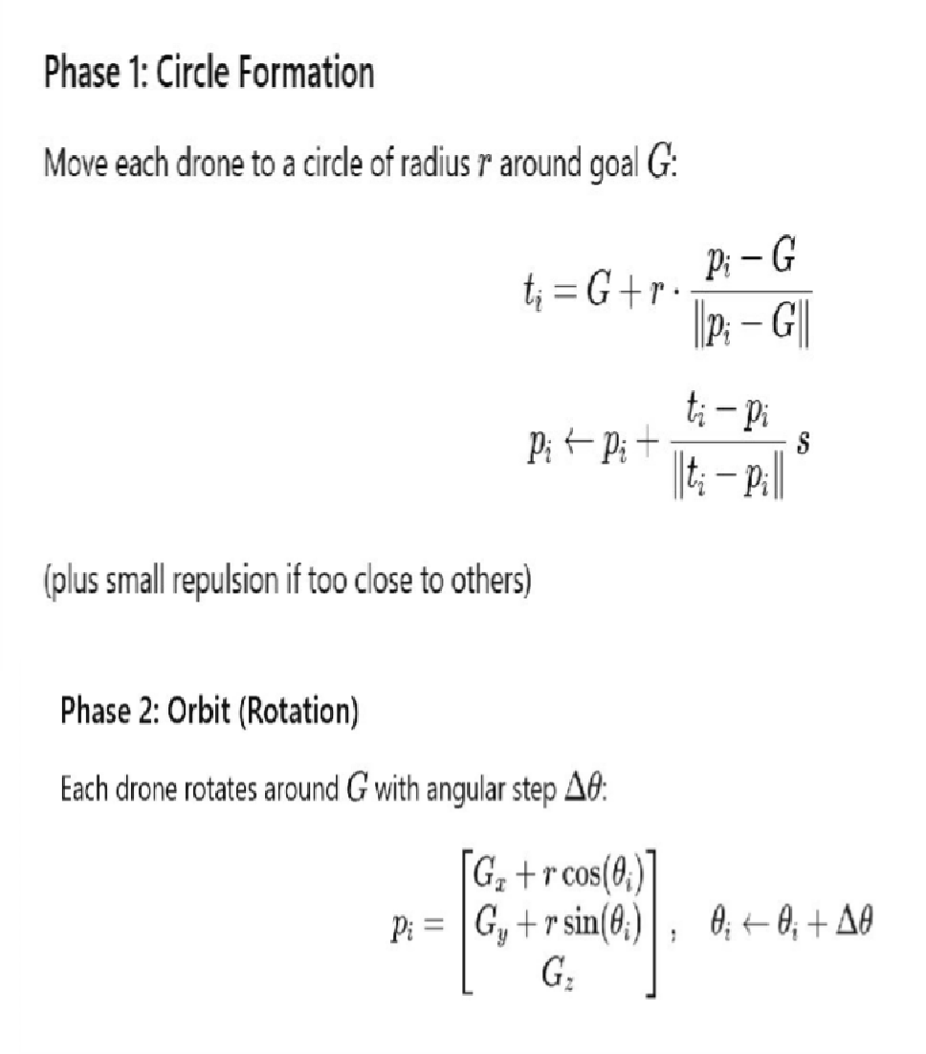
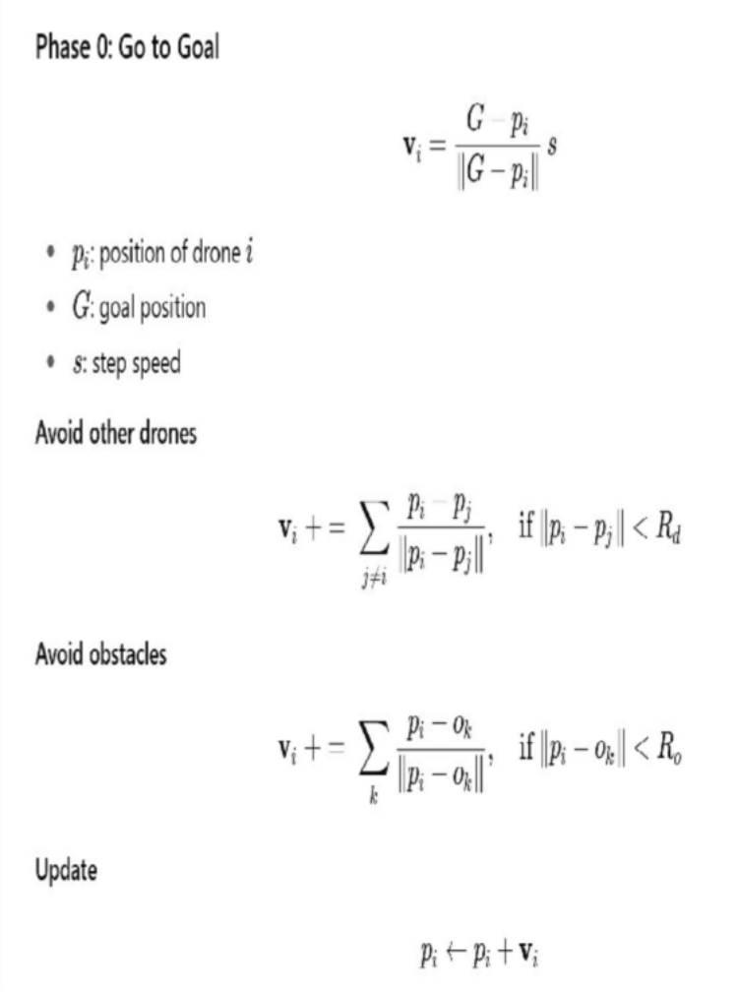
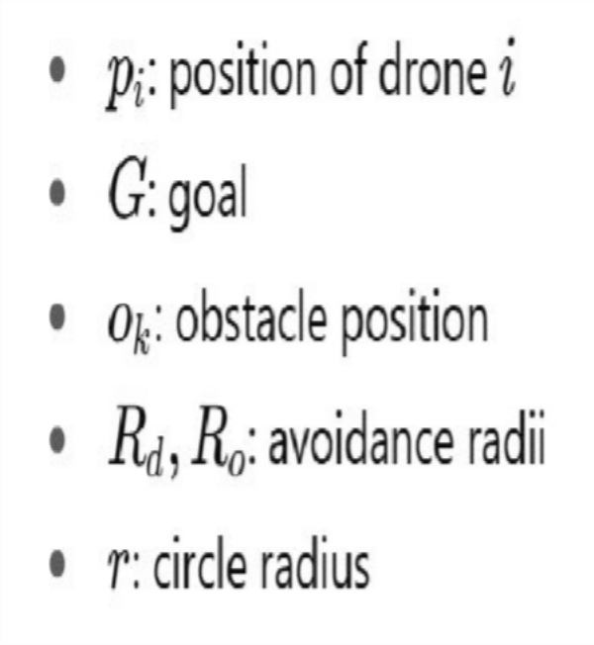
Equations used

Slide 13
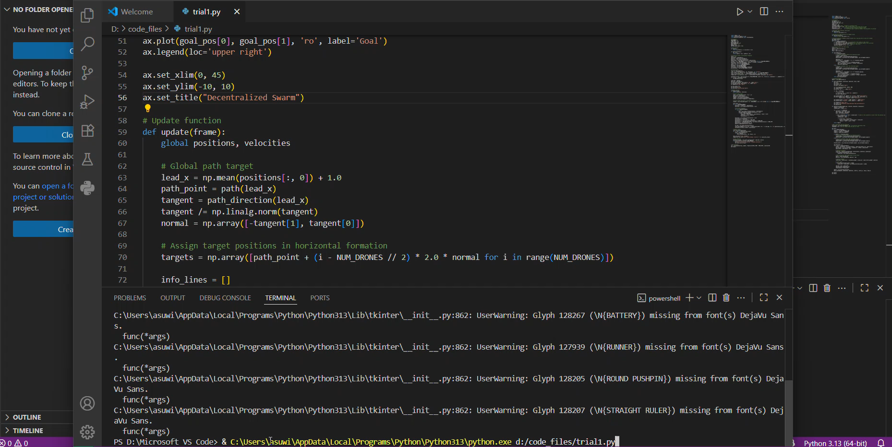
Horizontal Formation – Decentralized Approach

Slide 14
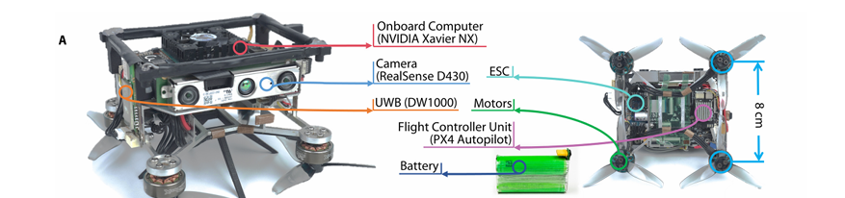
Ego planner V2 - Swarm of Micro Flying Robots in the Wild

Slide 15
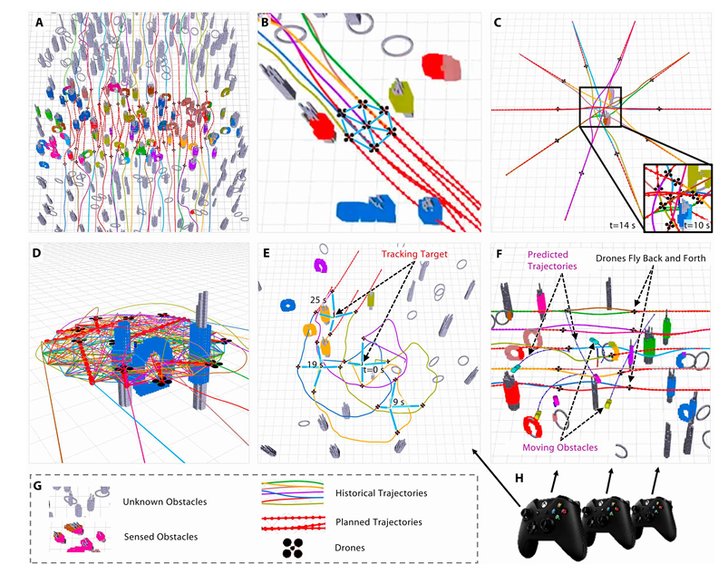
Software

Slide 16
Problem statement and challenges:
Experimental Results Overview:
Autonomous swarm navigation in dense wild environments (e.g., bamboo forests).
Challenges: Unknown surroundings, narrow gaps (<30cm), obstacle avoidance, inter-drone coordination.
TEEM goals: Optimize trajectory, extend to diverse tasks, minimize compute time, fit miniature drones.
Current limitations: Reactive methods lack optimality; centralized systems lack scalability.
Dense Forest: 10 drones navigate 65m with smooth trajectories
Formation Navigation: Maintains shape in woods, adapts to obstacles
Reciprocal Avoidance: 10 drones in 3m circle, 150 goals reached safely
Tracking: 4 drones follow human, handles occlusion with RGB cameras .
Validation: Full autonomy, TEEM success in real-world conditions.

Slide 17
Simulation of decentralized Swarm
Objective: Simulate 5 drones navigating a 50x50 grid with 40 obstacles to reach unique goals.
Key Features:
Environment: 50x50 grid with obstacles denser near top-right ([45, 45]).
Drones: Start in bottom-left ([0, 12.5]x[0, 12.5]), move to goals near center ([25, 25]).
Navigation:
APF: Attracts drones to goals, repels from obstacles.
ORCA: Avoids collisions with other drones/obstacles.
RRT: Plans paths when stuck or colliding.
B-spline: Smooths paths for natural movement.
Visualization: Matplotlib shows drones (blue circles), obstacles (brown circles), goals (green stars), and trails (blue lines).
Simulation Parameters:
Drones: 5, Obstacles: 40, Max Speed: 2 units/s, Time Step: 0.2s.
Runs until all drones reach goals or 60s (300 steps).

Slide 18
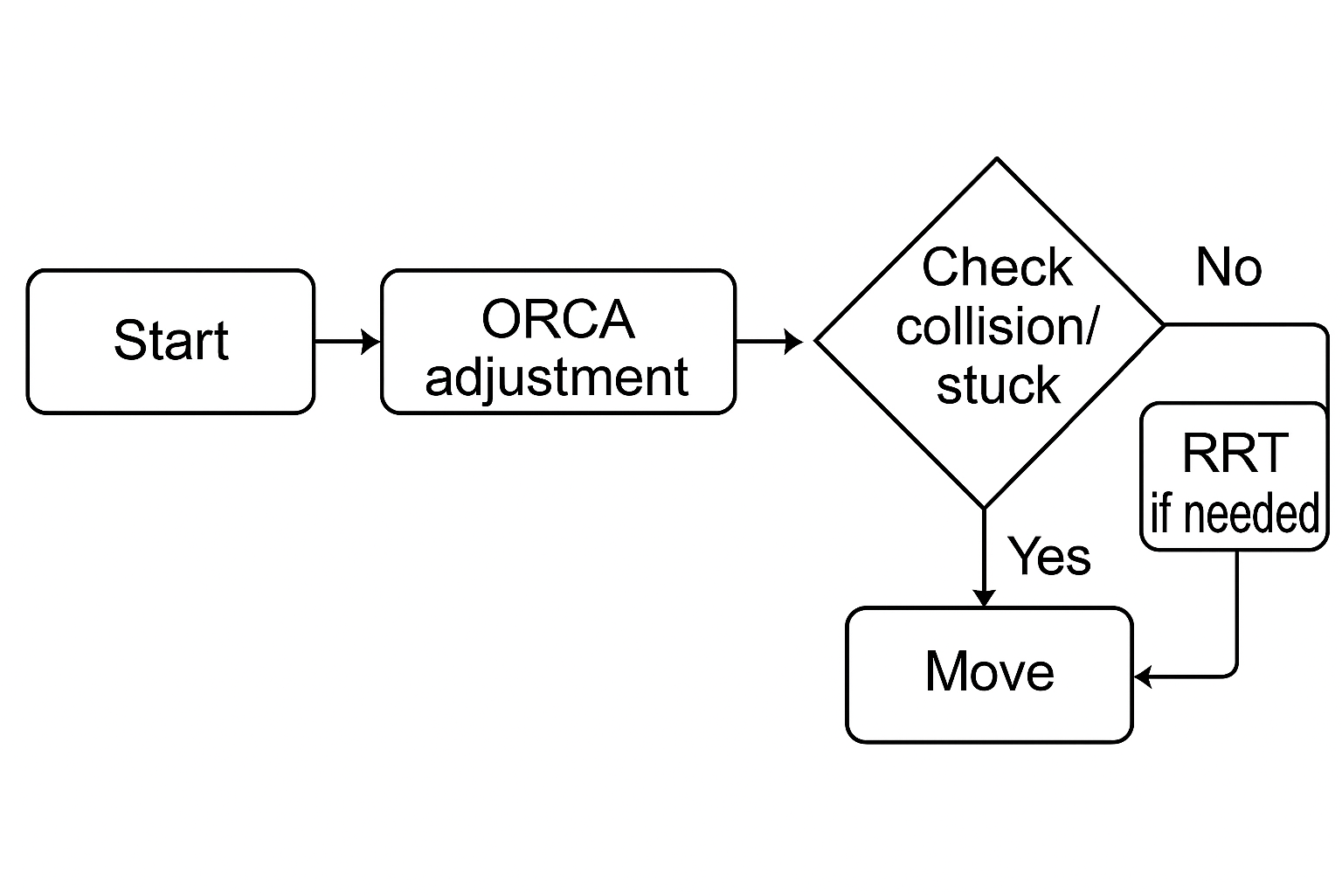
Flowchart of the simulation

Slide 19
Technical Details and Algorithm
Drone Class:
Attributes: ID, position, velocity, goal, path (for trails), reached status.
Core Algorithms:
APF (Artificial Potential Fields):
Attracts to goal
Repels from obstacles:.
ORCA: Adjusts velocity to avoid drones/obstacles within safe radius (2.0 units).
RRT: Plans collision-free paths (200 iterations, 10% goal bias) when stuck or colliding.
B-spline: Smooths paths (linear for 2 points, quadratic for 3, cubic for 4+).
Simulation Loop:
Updates positions/velocities every 0.2s.
Checks collisions, stuck status (velocity < 0.05 for 5 steps).
Plots trails for path visualization.
Outcome: Drones reach goals safely, visualized with trails.

Slide 20
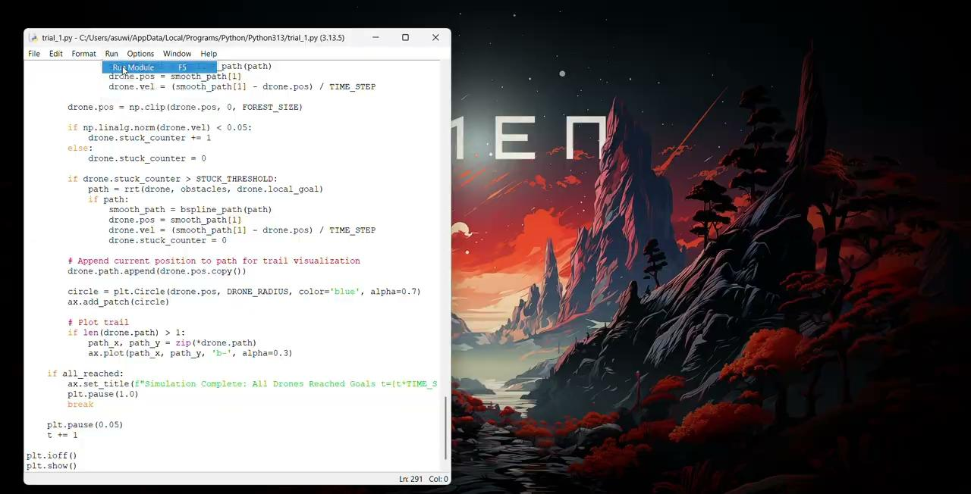
Simulation

Slide 21
Future Work
Decentralized Control – Develop fully distributed decision-making without central authority.
Robustness – Ensure resilience against failures, noise, and dynamic environments.
Scalability – Extend framework to handle large-scale swarms with minimal computation.
iv. Autonomous Coordination – Enable self-organization for formation, path planning, and task allocation.
iii.

Slide 22
Applications
Search & Rescue Operations
Rapid area coverage
Victim localization in disaster zones
Environment Mapping
3D terrain and infrastructure mapping
Real-time data collection over large regions
Defence & Surveillance
Border monitoring and patrolling
Threat detection with persistent coverage

Slide 23
Thank You!

